Slide 1

EFFECT OF MODERN AGRICULTURE
“ The ultimate goal of farming is not the growing of crops , but the cultivation and perfection of human being”
PRESENTED BY :- SANYA SRIVASTAVA SANDEEP SINGH

Slide 2
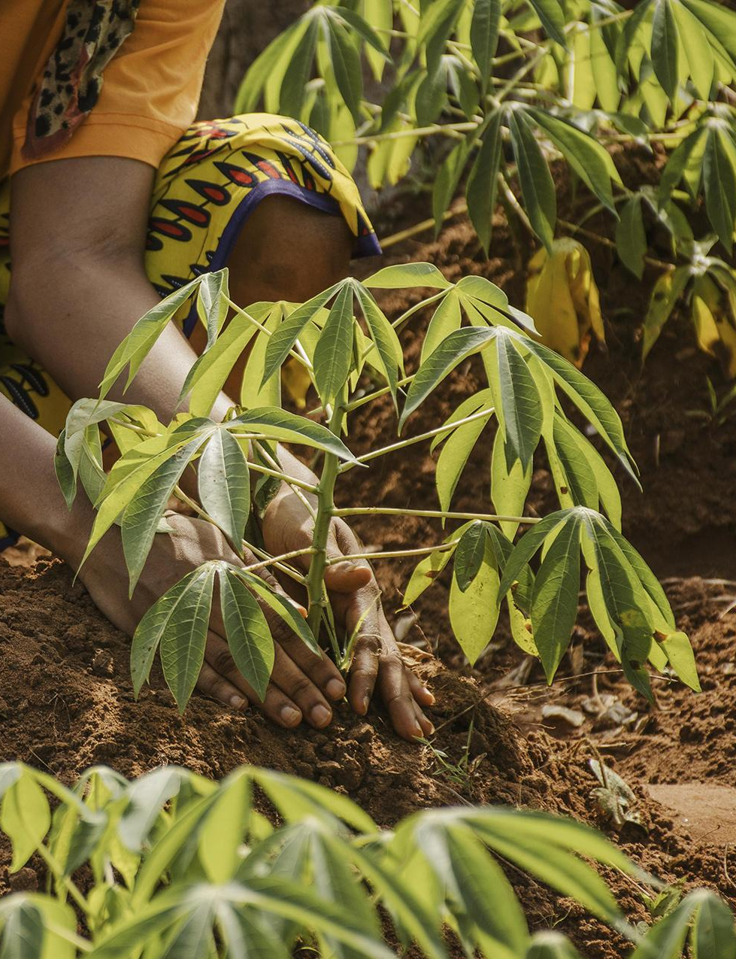
AGRICULTURE
Agriculture is the practice of cultivating plants and raising animals for various purposes, including food production, fiber, biofuels, and other raw materials.
It is a fundamental aspect of human civilization and has evolved significantly over thousands of years. There are two types of agriculture : 1. Traditional Agriculture 2. Modern Agriculture

Slide 3
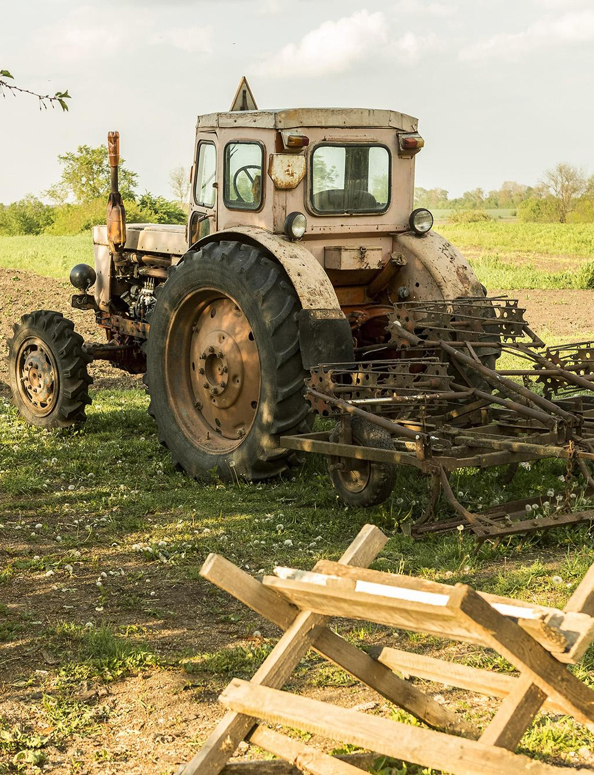
MODERN ARGRICULTURE
Modern agriculture refers to contemporary farming practices and technologies that increase the efficiency and productivity of food and fiber production. It encompasses a wide range of innovations and methods designed to meet the demands of a growing global population and address various challenges such as food security, environmental sustainability, and economic viability.

Slide 4
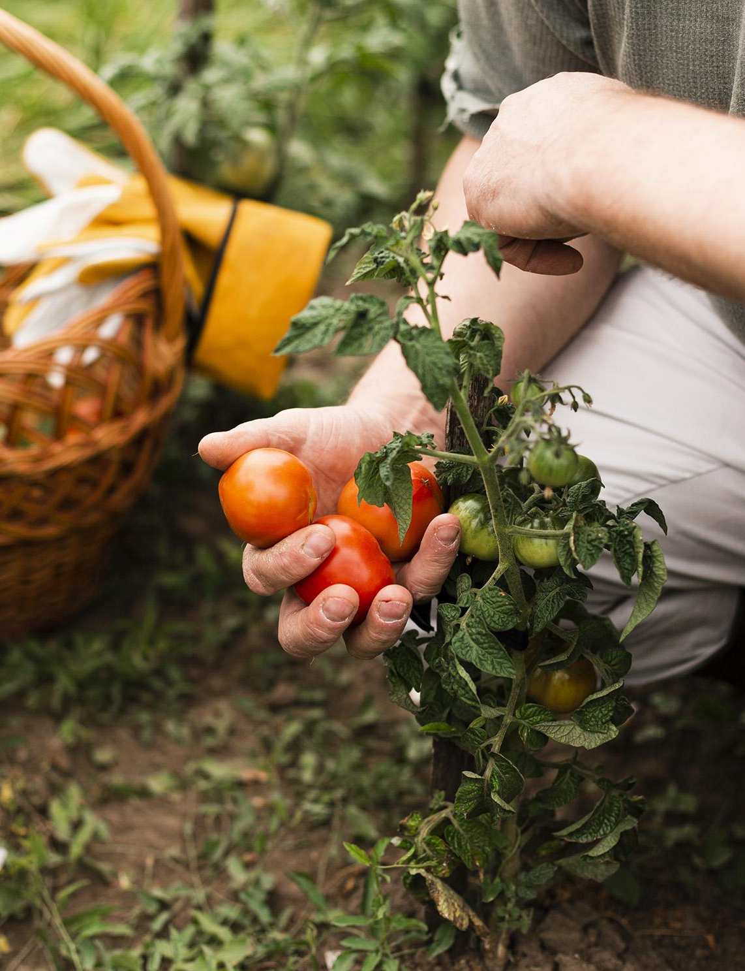
INCREASE FOOD PRODUCTION
Increasing food production is a crucial challenge in today's world, given the growing global population and the need to ensure food security. There are various strategies and approaches to increase food production sustainably and efficiently:
Crop Diversification
Fertilization
Genetic Modification
Sustainable Livestock Practices
Urban Agriculture

Slide 5
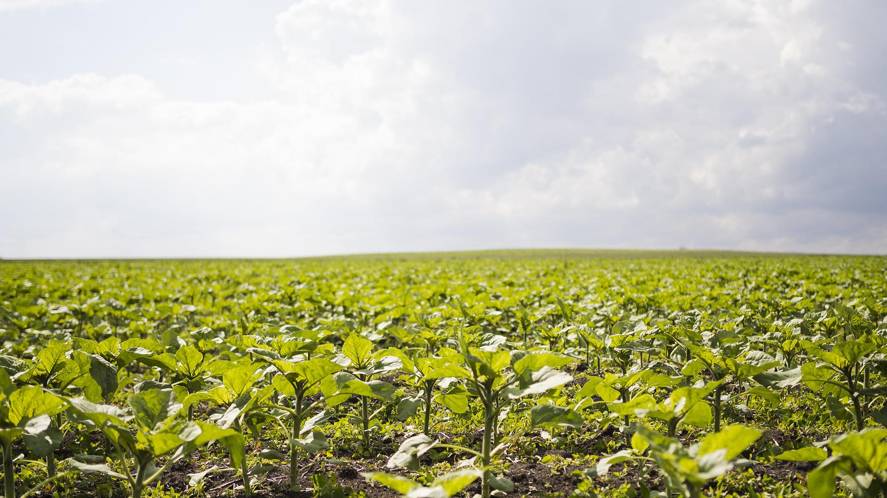
IMPROVED CROP VARIETY
Improved crop varieties are developed through selective breeding or genetic modification to possess desirable traits that enhance their productivity, resilience, nutritional value, and overall quality. These improved varieties play a critical role in increasing food production and ensuring food security.

Slide 6
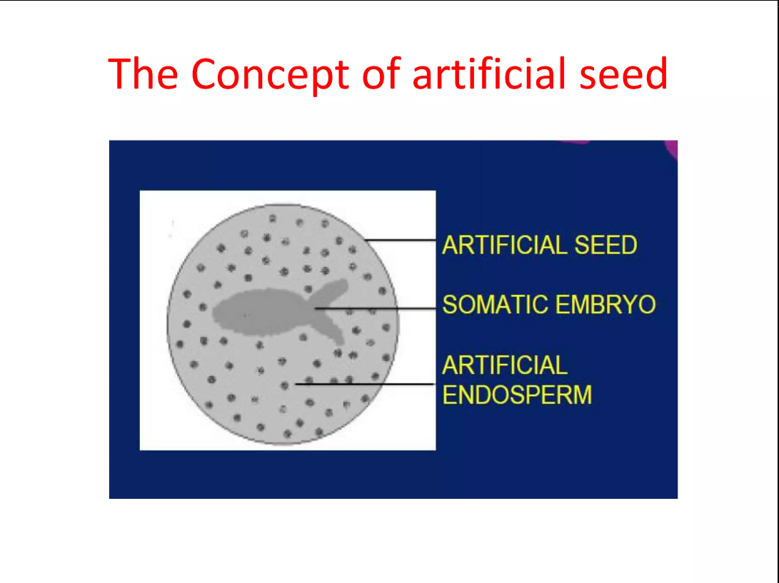
Artificial Seed
An artificial seed (also called a synthetic seed , seed analog, or manufactured seed) includes a range of plant structures, including somatic embryos, buds, shoots, or other tissues inside a coating, that can be sown in the same way as a conventional seed to produce a new plant. The coating may be water impermeable or water soluble and may also enclose nutrients and other additives deemed necessary.

Slide 7

ECONOMIC GROWTH
Agriculture plays a significant role in India’s growing economy. With around 54.6% of the total workforce involved in agriculture and allied sector activities, the sector contributes to 17.8% of the country’s gross value added (GVA). 1) Employment 2) Exports and Trade 3) Infrastructure Development 4) Technological Innovation 5) Rural Development

Slide 8

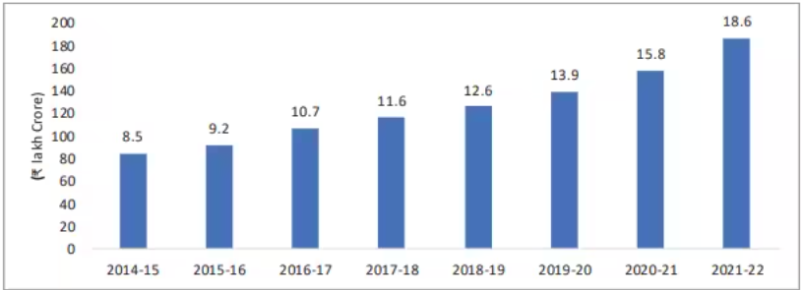
Increase of Agriculture Sector

Slide 9
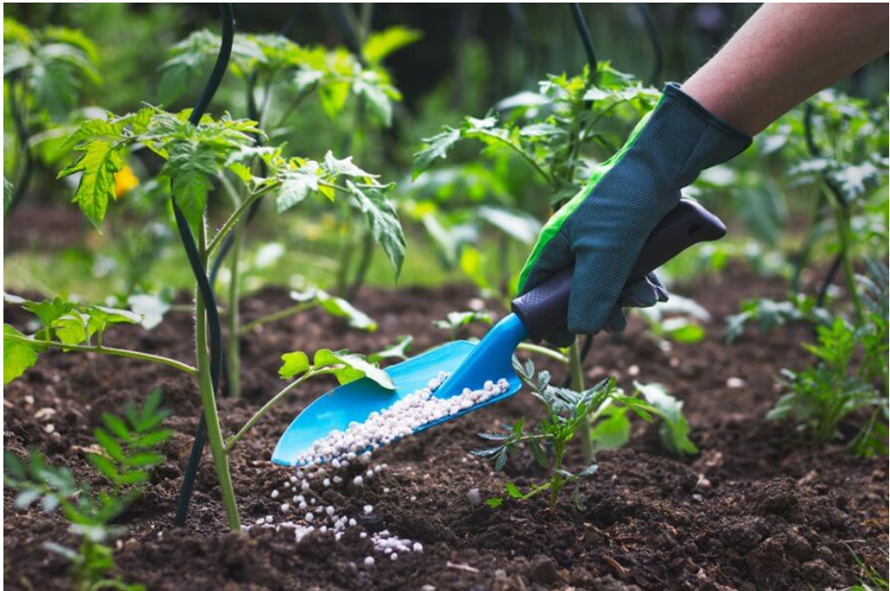
EFFECTS OF MODERN AGRICULTURE

Slide 10
Impact of excessive use of fertilizers
Fertilizers are the chemical substance that promote the plant growth. Their excessive use cause many problems.
A. Micro nutrient imbalance
Chemical fertilizers used in modern agriculture contain nitrogen , phosphorous and potassium .
Which are macro nutrient.
Excessive use of fertilizers in field causes micro nutrient imbalance by impending the intake
Of other minerals.
Example : in Punjab and Haryana excessive use of fertilizers have caused
deficiency of micro nutrient zinc thereby affecting productivity
of soil .

Slide 11
B. NITRATE POLLUTION :
Excess nitrogenous fertilizers applied in field leach deep into the soil contaminating the groundwater.
If the concentration of nitrate in drinking water exceeds 25 mg/ litre , it lead to fatal condition in new born babies .
Methemoglobinemia is also called “blue baby syndrome .” it is a condition where a baby skin turns blue.
This is happens when there is not enough oxygen in the blood .
The most common cause of blue baby syndrome is water contaminated with nitrates .
After a baby drinks nitrate rich water , the baby convert the nitrate in to nitrites. These nitrites bind to the hemoglobin in the body , forming methemoglobin, which is unable to carry oxygen .

Slide 12

Blue baby syndrome

Slide 13
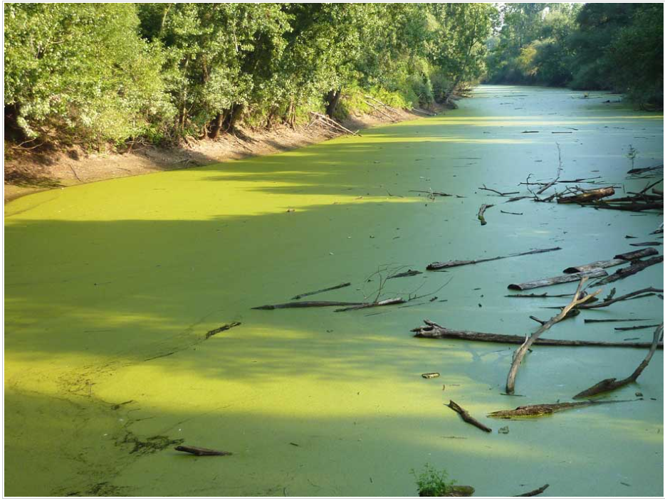
C. Eutrophication:
It is derived from the Greek word eutrophos “ well nourished”
The application of excess fertilizers in field lead to wash off the nutrient loaded water into nearby lakes cause over nourishment. The process is known as eutrophication.
It result into the sharp increase in the primary growth causes water body to cover with algal blooms ( algal mat) .
This process also increase the BOD of the water body .
Example : Chilka lake in Odisa
Dal lake in Srinagar

Slide 14
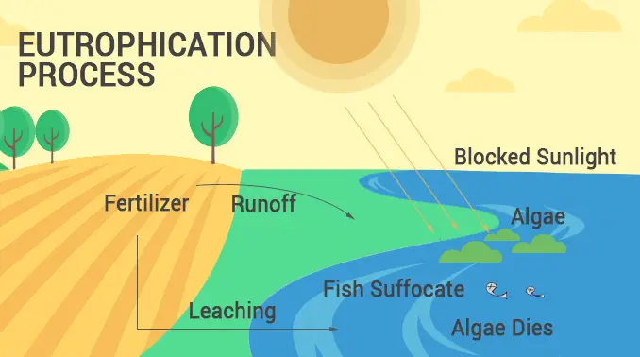

Slide 15
2. Pesticides : Pesticides are chemicals that deter and eliminate certain pest populations including insects, rodents, fungi, weeds, and other animals.
Impact of pesticides on environment :
Surface water contamination. When these pesticides are applied to fields or other surfaces, they can be transported to nearby surface water bodies through various pathways, leading to contamination.
Runoff: Rainfall or irrigation water can carry pesticides from treated fields into nearby rivers, lakes, and streams. This runoff is a common route for pesticides to enter surface waters.
2. Drift: Pesticide particles can become airborne during application and be carried by wind to nearby water bodies. This is known as pesticide drift.
3. Leaching: Pesticides can percolate through the soil and reach groundwater, which may eventually discharge into surface water bodies.

Slide 16
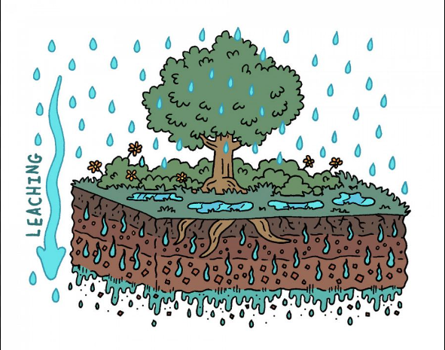
B . Ground water contamination : chemicals used in agriculture, landscaping, and pest control, can seep through the soil and reach groundwater through various mechanisms. Here are some key factors and consequences of groundwater contamination due to pesticides:
Leaching
Aquifer Contamination
Ecological Impact
C . Non-target organisms : Pesticides can directly harm non-target organisms through toxicity. Some non-target species may come into contact with or ingest pesticides accidentally. This can lead to immediate injury or death.
Example :Bees, butterflies, earthworms etc.
E . Bio magnification
The concentration of the toxic substance increase several times when it transferred one organism to another in the tropic level of food chain is known as
Bio magnification example DDT ( dichloro diphenyl trichloroethane)

Slide 17
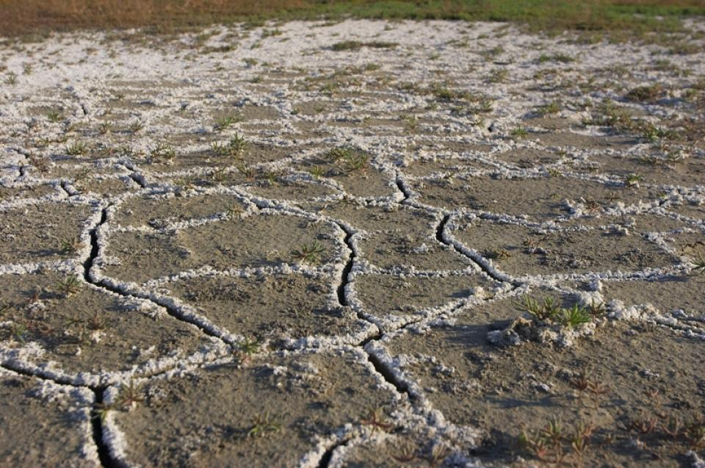
Salinity
Soil salinity created when water is not absorbed by soil and is evaporated leaving behind a thin layer of dissolved salts
Salts like : calcium chloride , magnesium chloride, sodium sulphate, sodium carbonates .
Saline soil cause decline in crop yield.
It also decrease soil biodiversity & the activities of micro organisms

Slide 18
Causes :
Excessive use of Fertilizers which containing (salts like potassium chloride)
Excessive water supply to the crop
Heavy rain
Poor drainage
Control measures :
Flushing soil and preventing evaporation
Improve drainage
Appy chemical treatment

Slide 19
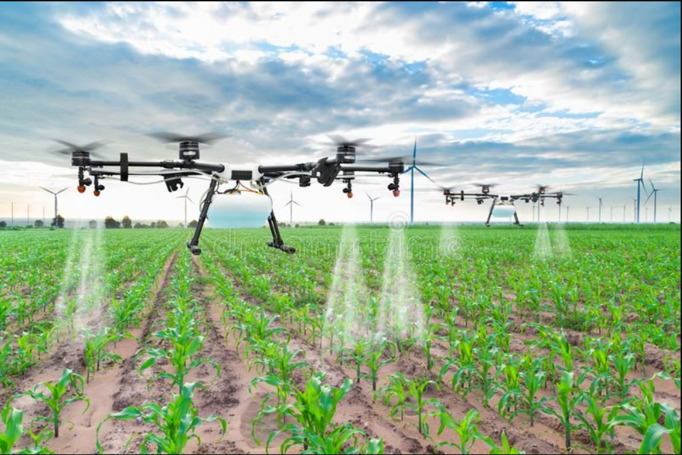

How to grow crops without effecting environment ?
1. Precision Agriculture 2. Biotechnology 3. Sustainable Farming 4. Waste Recycling

Slide 20

CASE STUDY
The DDT( Dichloro diphenyl trichloroethane) played a role in the decline of bald eagle and other bird of prey population.
Eggshell thinning. Premature breakage eggshell thinning. Premature b In 1972 DDT was banned from most uses in the united states.

Slide 21
THANKYOU! Does any one have questions?

